Slide 1
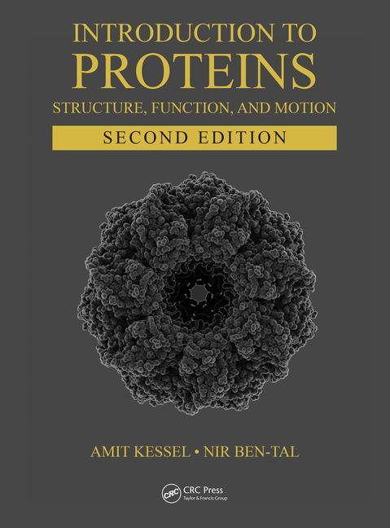
This PPT presentation is provided as suppl. material to the book:
Introduction to Proteins: Structure, Function, and Motion
2nd Edition (2018)
Amit Kessel & Nir Ben-Tal

Slide 2
Chapter 6:
Intrinsically Unstructured Proteins (IUPs)

Slide 3
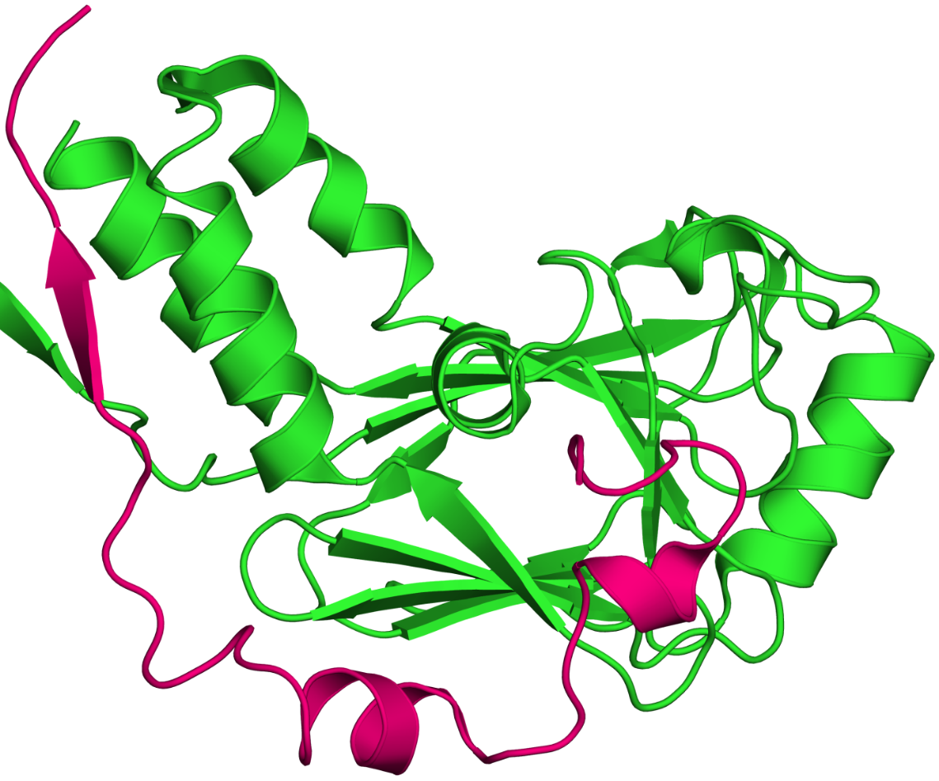
Levels of disorder
Regions (IDRs)
The disordered SBD domain (pink) of SARA ('Smad Anchor for Receptor Activation') bound to the Smad2 MH2 domain (green)
Notes:
Figure 6.1. Protein disorder. (a) Disorder of a relatively short stretch of a polypeptide chain (PDB entry 1dev) ^{ϴ}. The image shows the disordered Smad-binding domain (SBD) domain (pink) of SARA (Smad Anchor for Receptor Activation), bound to the Smad2 MH2 domain (green). The SBD domain is one of the relatively few cases in which binding of an IUP to its target does not induce folding into a compact structure. Although the domain contains three short segments of helical/strand conformations, most of the length of the polypeptide chain is unstructured and extended.

Slide 4
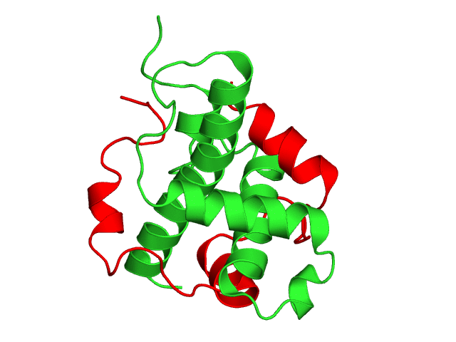
Levels of disorder
A dynamic view (GIF animation):
Notes:
Figure 6.1. Protein disorder. The animation was produced by intarpolation between the different conformations in the PDB file 1l8c.

Slide 5
Levels of disorder
Whole protein (IUP)
20 NMR structures of the intrinsically unstructured thylakoid soluble phosphoprotein
Notes:
Figure 6.1. Protein disorder. (b) Large-scale disorder. The image shows 20 NMR structures of the intrinsically-unstructured thylakoid soluble phosphoprotein (PDB entry 2fft) (each structure is colored differently), illustrating the very large conformational freedom of the unstructured chain.

Slide 6
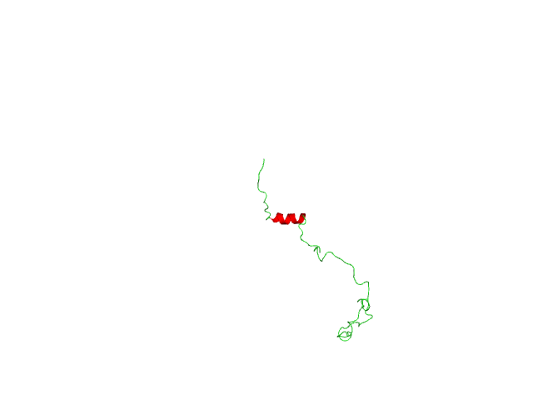
Levels of disorder
A dynamic view (GIF animation):
Notes:
Figure 6.1. Protein disorder. (b) Large-scale disorder. The animation was produced by intarpolation between 20 NMR structures of the intrinsically-unstructured thylakoid soluble phosphoprotein (PDB entry 2fft), illustrating the very large conformational freedom of the unstructured chain.

Slide 7
IUPs are involved in various aspects of cellular existence
Cell cycle and gene expression
DNA packing
Cellular transport and trafficking
Communication and signaling
Regulation
Common pathologies (e.g. cancer, cardiovascular diseases)
Database: http://www.disprot.org
Notes:
The full scale of IUPs and IDRs involvement in cellular functions is difficult to determine. Bioinformatic methods predict 25% of all proteins to be IUPs and 50% to contain long IDRs (correspond to 75% of all signaling proteins).

Slide 8
IUPs are involved in various aspects of cellular existence
How are IUPs and IDRs studied?
Not by X-ray crystallography (only for ordered structures)
Spectroscopies: NMR/EPR, CD, single-molecule FRET
High-speed atomic force microscopy
Raman optical activity
Time-resolved small angle X-ray scattering (TR-SAXS)
Computational: - IUPred, DISOPRED (prediction)
- Molecular dynamics (characterization)

Slide 9
Specific functions
Molecular recognition (often fold during function)
Assemblers: act as scaffolds in the assembly of large protein complexes (ribosome, cytoskeleton, chromatin)
Effectors: regulate the activity of other proteins or other regions of the same protein (e.g. p21 and p27 in cell cycle regulation)
Scavengers: store and/or neutralize small ligands (e.g. casein)
Display sites (IDRs): targets for post-translational modifications
Chaperones: assist the folding of proteins and RNA molecules
(Nat Rev Mol Cell Biol. 6:197)
Notes:
Casein prevents the precipitation of calcium-phosphate crystals in milk by scavenging calcium.
IUP chaperons do not require ATP, in contrast to the large chaperonins.
RNA chaperons require a larger degree of disorder than in other IUPs.
Figure 6.2. IUP-protein complexes involving partial folding. In each case, the IDR undergoing disorder-to-order transition upon binding is shown as a blue ribbon, whereas the regions that remain unfolded (unresolved in the X-ray structure) are illustrated as red amino acid spheres representation. The water-accessible surface of the binding partner is shown. (a) The completely disordered protein 4E-BP1 bound to eukaryotic initiation factor 4E (eIF4E) (PDB entry 1EJ4). (b) The IUP protein phosphatase inhibitor 2 bound to type 1 protein phosphatase via three discrete regions connected to, and flanked by, disordered regions (PDB entry 2O8A).

Slide 10
Specific functions
Entropic chain activity
Create a force that opposes structural changes, or affects the orientation/localization of attached domains within the protein
Do not fold during ‘activity’
Types:
Springs: generate 'passive force' (e.g. to restore relaxed muscle length when overstretched)
Bristles: keep adjacent segments of the chain separated
Linkers: link protein regions (e.g. domains), thus allowing them to acquire different orientations with respect to each other.

Slide 11
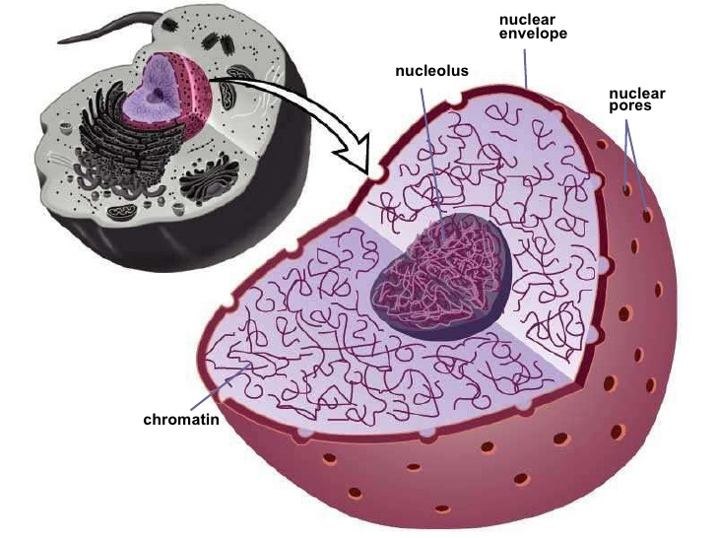
Example: the nuclear pore complex (NPC)
Role: cytoplasm ↔ nucleoplasm transport:
Cytoplasm → nucleoplasm: DNA polymerase, TF, carbohydrates, signaling molecules, lipids
Nucleoplasm → cytoplasm: messenger RNA, ribosomal precursors
http://www.slideshare.net/sanisaddam/cell-structurefunction
Notes:
Targeting signals on cargo: 'Nuclear localization signals' (NLS) in the case of imported proteins, and 'nuclear export signals' (NES) is the case of exported proteins.

Slide 12
Example: the nuclear pore complex (NPC)
Includes ~456 individual protein molecules (~30 types)
Inner diameter 380Å
Outer ring nucleoprotein
Inner ring nucleoprotein
Nuclear envelope
Membrane ring
Notes:
Figure 6.1.1. The structure of the NPC. The nucleoporins composing the NPC are colored according to their classification into five distinct substructures on the basis of their location and functional properties: the outer rings in yellow, the inner rings in purple, the membrane rings in brown, the linker nucleoporins in blue and pink, and the FG nucleoporins in green. The pore membrane is shown in grey. The central structure contains all rings, whereas the structures surrounding it show each ring separately, for clarity. The bottom structure shows a cross section through the NPC. A 5-nm size scale is shown at the bottom of the image. The figure is based on the structure of Alber et al. ^{[54]}, and is taken from ^{[60]}.

Slide 13
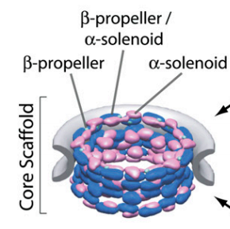
Example: the nuclear pore complex (NPC)
Most NPC proteins are ordered. The dominant folds:
β-propeller: tough
α-solenoid: flexible, allows accommodating the large cargo
Notes:
Figure 6.1.2. The β-propeller and the α-solenoid folds of NPC coat proteins. (a) The location of the scaffold proteins containing these folds in the NPC (taken from ^{[60]}). (b) The β-propeller fold of Seh1 (PDB entry 3ewe, chain A). (c) The α-solenoid fold of Nup85 (PDB entry 3ewe, chain B).

Slide 14
Example: the nuclear pore complex (NPC)
The FG proteins at the center have a large disordered region
This region can reach both nucleoplasm and cytoplasm – possible cargo docking site?
Molecules ≤ ~10 Å can pass freely in the central space
Notes:
The FG nucleoproteins at the center of the NPC are rich in Phe and Gly, hence the name.
For the FG IDRs to serve in transport, the transported cargo proteins must contain a binding patch composed of nonpolar residues (hypothetical).
Figure 6.1.3. Distribution of the disordered FG-repeat regions in the NPC. (a) Slice through the NPC, showing the structured domains of all nucleoporins, colored according to their classification (see Figure 6.1.1). Also shown are the localization probabilities of the unstructured regions of all FG nucleoporins (green cloud). (b) Projection of the localization probabilities of the FG-repeat regions from all the FG nucleoporins is shown by a density plot, sampled in a plane perpendicular to the central Z-axis from X = -50 Å to X = +50 Å. Projections from the FG-repeat regions belonging to FG nucleoporins anchored mainly or exclusively on one side of the NPC are indicated: red for those that are cytoplasmically disposed, blue for those nucleoplasmically disposed, and white for those that are present to equal degrees on both sides. The equatorial plane of the NPC is indicated by a dashed white line, the position of the NPC density is indicated by a dashed grey line, and the position of the pore membrane is shown in purple. A scale bar of 25 nm (250 Å) is shown. The figure was taken from ^{[54]}.

Slide 15
Example: the nuclear pore complex (NPC)
The different IDRs overlap – possible transport mechanism:
Cargo protein might shift quickly between different FG nucleoproteins, allowing it to traverse the pore in minimal time (~5 ms)
Notes:
The FG nucleoproteins at the center of the NPC are rich in Phe and Gly, hence the name.
For the FG IDRs to serve in transport, the transported cargo proteins must contain a binding patch composed of nonpolar residues (hypothetical).
Figure 6.1.3. Distribution of the disordered FG-repeat regions in the NPC. (a) Slice through the NPC, showing the structured domains of all nucleoporins, colored according to their classification (see Figure 6.1.1). Also shown are the localization probabilities of the unstructured regions of all FG nucleoporins (green cloud). (b) Projection of the localization probabilities of the FG-repeat regions from all the FG nucleoporins is shown by a density plot, sampled in a plane perpendicular to the central Z-axis from X = -50 Å to X = +50 Å. Projections from the FG-repeat regions belonging to FG nucleoporins anchored mainly or exclusively on one side of the NPC are indicated: red for those that are cytoplasmically disposed, blue for those nucleoplasmically disposed, and white for those that are present to equal degrees on both sides. The equatorial plane of the NPC is indicated by a dashed white line, the position of the NPC density is indicated by a dashed grey line, and the position of the pore membrane is shown in purple. A scale bar of 25 nm (250 Å) is shown. The figure was taken from ^{[54]}.

Slide 16
IUPs characteristics
Residual structure
Includes mainly PPII helices (10-20% of residues)
Binding-folding: mainly via linear motifs: (1) MoREs/MoRFs (10-70 aa sequences), and (2) SLiMs (shorter)
Sequence tendencies:
Pro overrepresented → prevents formation of stable 2nd structures
Polar residues overrepresented → prevents stable nonpolar core
Cys underrepresented → no S-S bonds to stabilize 3rd and 4th structures
Short linear motifs (SLiMs): low-affinity binding (fast exchange), PTMs sites
Low evolutionary conservation (no buried residues)
Notes:
MoREs/MoRFs (molecular recognition elements/features) - tend to be amphipathic.
The fact that IUPs have low conservation is used by certain prediction tools.
SLiMs that serve as ligand binding sites include the Tyr-containing motif recognized by SH2 domains and the PxxP motifs recognized by SH3 domains. They are shorter than MoREs/MoRFs.
PTMs are also easier to happen in IUPs because the chain is exposed.

Slide 17
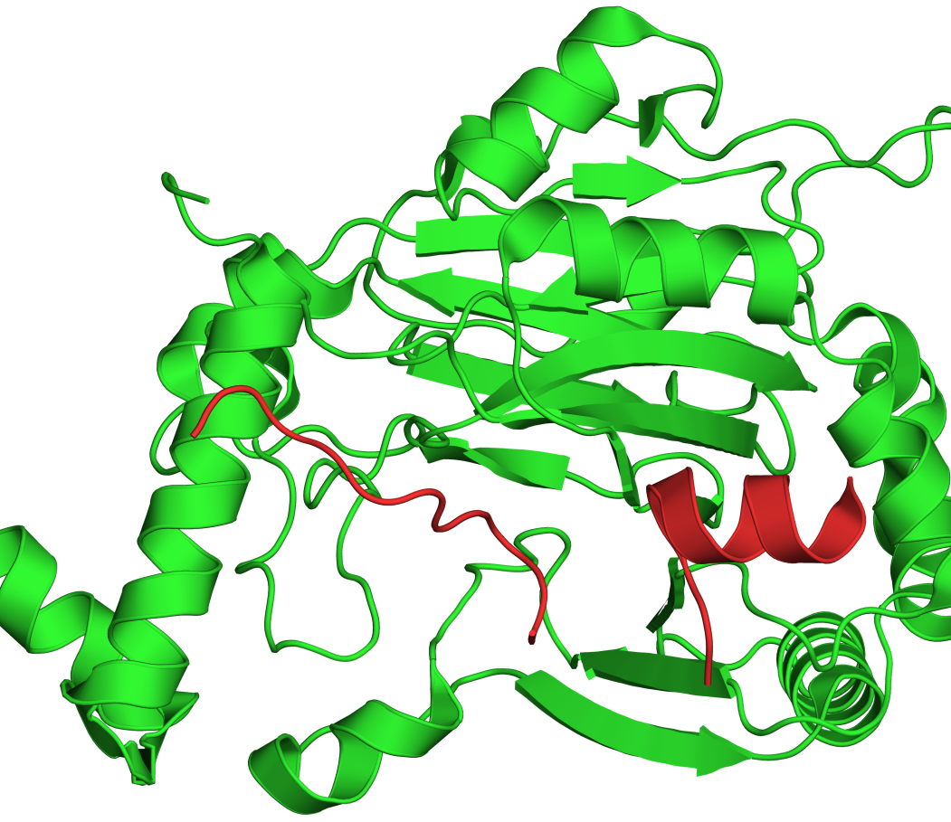
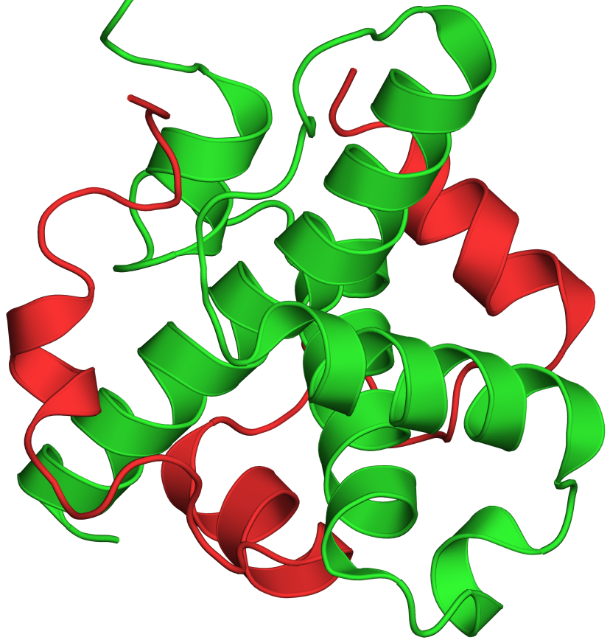
Structure-function relationship in IUPs
Conformational flexibility → plasticity of binding to different proteins under different conditions
a
b
The hypoxia-inducible factor-1α (red) bound to different targets
Notes:
As explained later, IUPs bind their ligands with higher specificity than globular proteins. Their higher binding plasticity does not contradict this specificity; plasticity means higher potential to bind other proteins upon change in cellular conditions. That is, under the same conditions IUPs are still expected to bind a single target protein.
Figure 6.4. Different conformations of HIF-1α when bound to different targets. The figure shows the C-terminal activation domain of the hypoxia-inducible factor HIF-1α (red) in complex with: (a) the transcription activation zinc finger (Taz1) domain of CREB-binding protein (CBP) (PDB entry 1l8c, green); (b) the inhibiting factor FIH (PDB entry 1h2k, green). As is clearly shown, HIF-1α has an α-helical conformation in the first complex, and a largely coiled conformation in the second. In the latter complex, six residues of HIF are missing (i.e., unresolved in the experiment), reflecting the disordered nature of this protein.

Slide 18
Structure-function relationship in IUPs
Binding affinity
Disordered structure → binding-folding coupling → larger ΔS_{bind} compared to globular proteins → weaker binding →
IUPs have higher partner exchange rate (advantage for signaling proteins)
IUPs cannot use ΔH_{bind} to drive catalysis → enzymes are never intrinsically disordered
Nonpolar binding interfaces → larger ΔH_{bind} that can compensate for the entropy loss
Notes:
The nonpolar binding interface in IUPs is responsible for the larger-than-usual contact surface per residue, thus increasing ΔH_{bind}.
In IUPs, ΔH_{bind} is used to compensate for the larger entropy loss, therefore it cannot be used to drive catalysis, as in globular proteins.

Slide 19
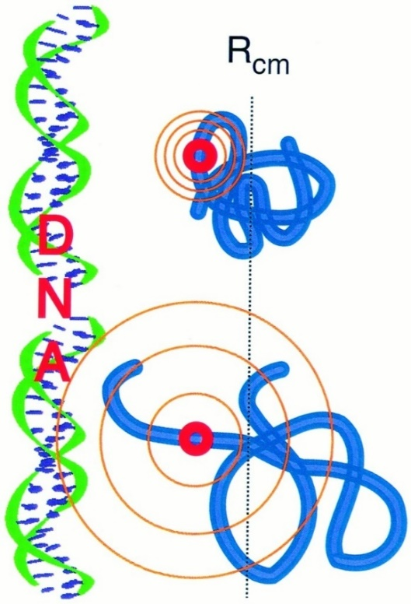
Structure-function relationship in IUPs
Binding-folding kinetics (2-step "fly casting" mechanism)
Initial, weak binding of partially-folded IUP → easy sampling of many conformations
Reaching a high affinity conformation → stronger binding
Notes:
The fly casting mechanism is similar to the induced fit mechanism in globular proteins, but much better since the protein can sample many more conformations.
Figure 6.5. Folding speed enhancement by the 'fly casting' mechanism. The figure shows a DNA-binding protein (right) interacting with its target (left). At an approach distance R_{cm}, the partially-folded ensemble is already able to interact weakly with its binding site. In contrast, the folded structure remains out of range because of the smaller fluctuations in the folded state. The weak interaction between the unfolded ensemble and the target molecule allows the former to search for and find its specific binding site within its bound partner, while completing the folding process. The figure was taken from ^{[100]}.

Slide 20
Structure-function relationship in IUPs
Binding specificity
Unsatisfied internal H-bonds in 2nd structures (folding is partial, PPII helices have no internal H-bonds) → more H-bonds available for ligand binding → specific binding
PPII helix with unpaired backbone polar groups
Notes:
PPII helix with unpaired backbone polar groups – taken from 1qsu (collagen-like peptide)

Slide 21
Structure-function relationship in IUPs
Regulation via post-translational modifications
Disordered structure → extended chain → high accessibility to modifying enzymes (phosphorylation, acetylation, ubiquitination, hydroxylation, and methylation)
Short-linear motifs (SLiMs) include specific determinants that are recognized by PTM enzymes (phosphorylation, SUMOylation, cleavage)

Slide 22
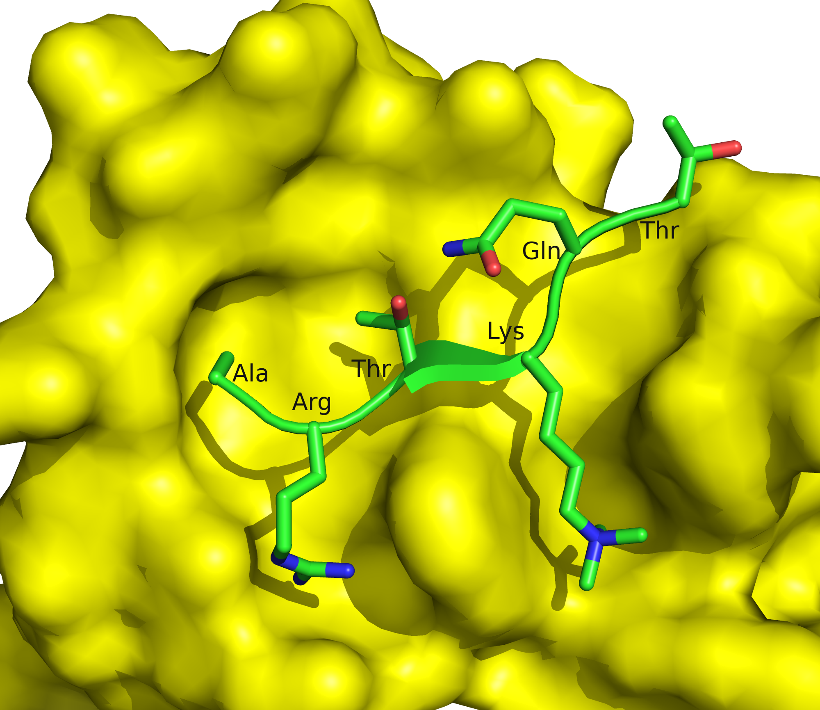
Structure-function relationship in IUPs
Regulation via post-translational modifications
Methylated Lys in short linear motif (histone-derived peptide), bound to human BPTF (2F6J)
Notes:
The methylation of lys-4 allows its fit to the BPTF binding site, which includes 3 tyrosine residues and 1 tryptophan.
Figure 6.3. Short linear motifs (SLiMs). (b) a methylated SLiM in a histone H3-derived peptide (shown as sticks), bound to human BPTF (yellow surface, PDB entry 2f6j). The histone tail corresponding to the peptide is disordered in the unbound form, and acquires a short β conformation upon binding. The addition of three methyl groups Lys-4 allows a good fit of this residue with the BPTF binding site.

Slide 23
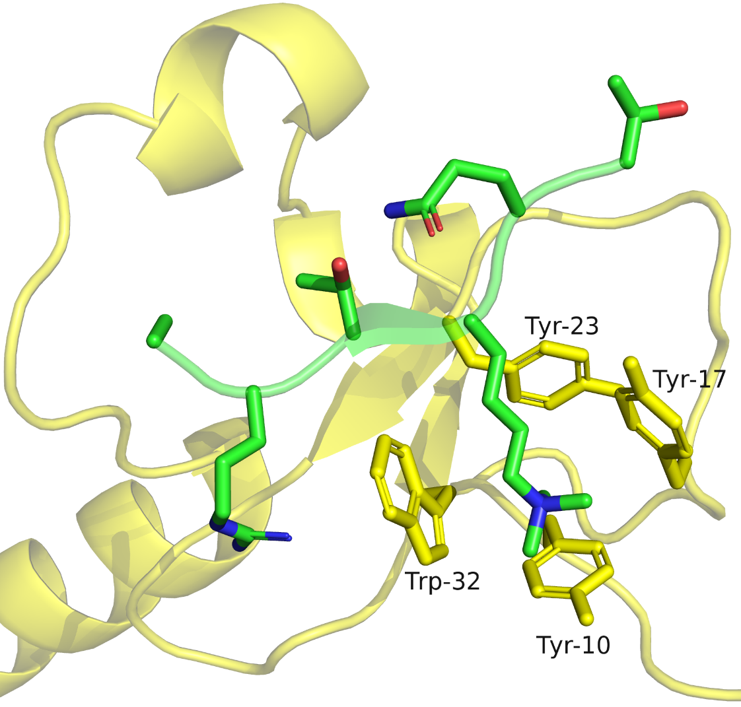
Structure-function relationship in IUPs
Regulation via post-translational modifications
Methylated Lys in short linear motif (histone-derived peptide), bound to human BPTF (2F6J)
Notes:
The methylation of lys-4 allows its fit to the BPTF binding site, which includes 3 tyrosine residues and 1 tryptophan.
Figure 6.3. Short linear motifs (SLiMs). (b) the addition of three methyl groups Lys-4 allows a good fit of this residue with the BPTF binding site, where it interacts with 3 tyrosine residues and 1 tryptophan (BPTF is shown as sticks with the partially transparent backbone for clarity). Histone lysine methylation is associated with the demarcation of transcriptionally active sites in eukaryotic genes.

