Slide 1
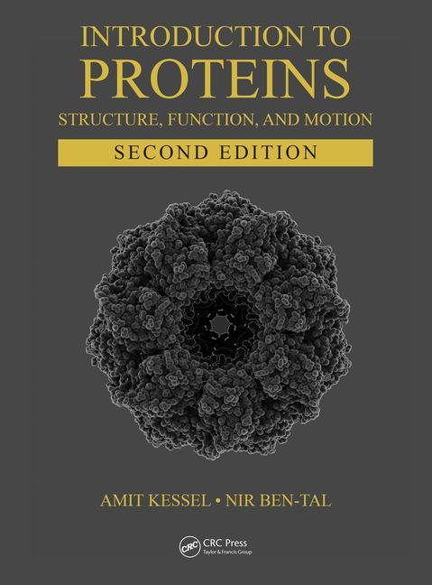
This PPT presentation is provided as suppl. material to the book:
Introduction to Proteins: Structure, Function, and Motion
2nd Edition (2018)
Amit Kessel & Nir Ben-Tal

Slide 2
Chapter 3:
Methods of Structure Determination & Prediction

Slide 3
Experimental Determination of Protein Structure

Slide 4
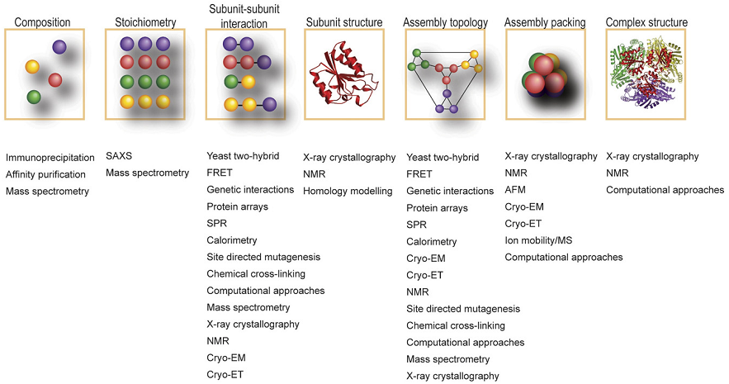
Protein structure can be studied by various biochemical & biophysical methods
Notes:
Figure 3.1. Biophysical, biochemical and genetic methods used to characterize different levels of protein 3D structure. AFM: atomic force microscopy; Cryo-ET: cryo-electron tomography; EM: electron microscopy; FRET: fluorescence resonance energy-transfer; NMR: nuclear magnetic resonance; SAXS: small-angle X-ray scattering; SPR: surface plasmon resonance. The image is taken from ^{[12]}.

Slide 5
Types of structure-determination methods
Diffraction methods:
X-ray diffraction/scattering
Neutron scattering
Electron microscopy/crystallography
Spectroscopic methods:
Nuclear magnetic resonance (NMR) spectroscopy
Electron paramagnetic resonance (EPR) spectroscopy
Others: FTIR, Raman spectroscopy, circular dichroism, mass spectrometry

Slide 6
X-ray diffraction (crystallography)
The most accurate method for the structural determination of proteins
Based on the diffraction of X-rays by the electron clouds of atoms in the sample
Provides high resolution:
wavelength
separation
Visible light: λ = 4000-7000 Å
X-rays: λ = 0.1-100 Å
Notes:
Since X-rays cannot be focused by lenses (like EM waves), scientists do not look at their passing through the sample, but rather by inspecting their diffraction by the sample.

Slide 7
X-ray diffraction (crystallography)
Steps:
X-rays are fired at a 3D crystal of the protein
The diffraction pattern is mathematically (FT) converted to electron density map
Notes:
The need for crystallization stems from the weak diffraction of light atoms (C, N, O and H). The diffraction can be boosted by using a sample in which all molecules are arranged in the same way in space (i.e., a crystal).
The electron density map presents graphically the locations in space where the density of electrons is high enough to indicate the presence of atoms.
Figure 3.2. Structure determination using X-ray diffraction. (a-d) the structure determination process ^{[18]} [the figure in the paper is reproduced from Biomolecular Crystallography: Principles, Practice, and Application to Structural Biology by Bernhard Rupp. Garland Science/Taylor & Francis LLC © 2011]. The X-rays are passed through a rotating crystal (a) and the diffraction pattern is recorded (b). Since the diffraction images are not direct images of the molecule, the reciprocal space has to be back-transformed to direct space using the Fourier transform (FT). This, together with separately acquired phases for each diffraction spot allows reconstructing the electron density (blue grid) of the molecules self-assembled into the diffracting crystal (c).

Slide 8
X-ray diffraction (crystallography)
Steps:
The electron density map is used to construct a 3D model of the protein
Notes:
An atomic model of the structure is then built into the three-dimensional electron density (d).

Slide 9
X-ray diffraction (crystallography)
Steps:
This is done by using:
Knowledge on the physicochemical properties of amino acids
The amino acid sequence of the protein
Energy- and geometry-based calculations
Disordered/flexible regions (e.g. loops) tend to have low electron densities and may even be unresolved

Slide 10
X-ray diffraction (crystallography)
What does the diffraction experiment provide?
3D structure of the protein (Cartesian coordinates)
Deviation of atoms from their average location (B-factor) – may result from natural dynamics or static disorder
Atom number
Atom name
Residue name
Residue number
Occupancy
Chain
X
Y
Z
B-factor
Notes:
B-factor values usually range between 20 and 80, where values lower than 45 indicate ordered atoms, and values higher than 60 indicate flexible atoms.
Static disorder represents an ensemble of conformational variations of the molecule, which exist in solution and trapped in the crystal.

Slide 11
X-ray diffraction (crystallography)
What does the diffraction experiment provide?
Resolution:
4 Å
8 Å
16 Å
32 Å
Notes:
Figure 3.2. Structure determination using X-ray diffraction. (e) Illustration of the structural features of proteins visible at resolution values between 4 Å and 32 Å. The structure shown is that of GroEL (PDB entry 1j4z). The image is taken from ^{[19]}.

Slide 12
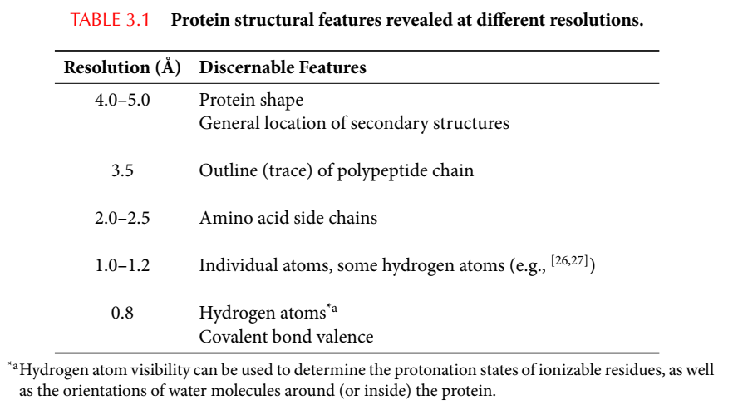
X-ray diffraction (crystallography)
What does the diffraction experiment provide?
Resolution:
Notes:
Resolutions of 1.2, 1.0 and 0.8 Å allow determining the location of some, most, and all hydrogen atoms, respectively. Only ~10% of the protein structures known today have resolutions allowing to know the location of hydrogen atoms, and therefore protonation states. For all the other structures, scientists use energy-based or statistical calculations to predict the protonation states of ionizable atoms.
Resolution of 0.8 Å or better also allows determining the distribution of electrons around atoms, i.e. bond valence and chemical reactivity.
Table 3.1 Protein structural features revealed at different resolutions. *hydrogen atom visibility allows determining the protonation state of ionizable residues, as well as the orientation of water molecules around (or inside) the protein.

Slide 13
X-ray diffraction (crystallography)
Web-based tools for predicting protonation states:
PropKa (via the PDB2PQR server)
http://nbcr-222.ucsd.edu/pdb2pqr_2.0.0/
Reduce (via the MolProbity server)
http://molprobity.biochem.duke.edu/
H++
http://biophysics.cs.vt.edu/
DelPhiPKa http://compbio.clemson.edu/pka_webserver/#started
Notes:
Less than 1% of the protein structures known today have resolutions allowing to know the location of hydrogen atoms, and therefore protonation states. For all the other structures, scientists use energy-based or statistical calculations to predict the protonation states of ionizable atoms.
Resolution of 0.8 Å or better – allows determining the distribution of electrons around atoms, i.e. bond valence and chemical reactivity.

Slide 14
X-ray diffraction (crystallography)
Main problems & difficulties :
Crystallization conditions change between proteins, require trial & error → time costly
Membrane-bound and large proteins are hard to crystallize, as well as flexible regions within the proteins
The crystal is an unnatural environment:
Structural deformation due to compaction forces
Dynamics is absent (only in solution)
Radiation damage → cryogenic experiments
Notes:
Membrane proteins are surrounded by lipids, which are flexible, and therefore do not tend to crystallize. Therefore, the lipids are usually replaced by detergents, but these may change their structure.

Slide 15
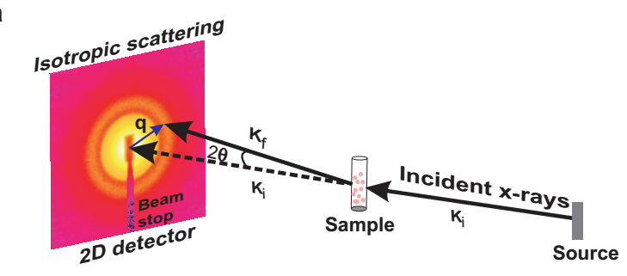
X-ray scattering (SAXS)
Principles:
The sample in solution is irradiated by low-angle X-rays, and the scattering pattern is registered by a detector
Notes:
The scattering angle, 2θ is the angle between the incident and scattered beams.
Figure 3.3. Small-angle X-ray scattering (SAXS). (a) The SAXS experiment. 2θ is the angle between the incident and scattered beam and q is the modulus of momentum transfer. Taken from Figure 3a in ^{[57]} (© IOP Publishing & Deutsche Physikalische Gesellschaft. CC BY-NC-SA).

Slide 16
X-ray scattering (SAXS)
Principles:
The intensity of the scattered rays (I) can be presented as a function of the momentum transfer (q)
Notes:
q, also called the magnitude of the scattering vector, is related directly to the scattering angle (2θ) by: q = 4πsinθ/λ (where λ is the wavelength of the X-ray beam).
(b) A typical SAXS profile. Adapted from ^{[58]} (figure 4d). The red circles are the measured intensities. At high q values, which correspond to smaller scattering angles, the measurements are particularly sensitive to structural details and changes in the sample. The black line is the calculated profile of a model structure.

Slide 17
X-ray scattering (SAXS)
Principles:
The 2D profile is proportional to the scattering from a single particle averaged over all orientations
Notes:
(b) A typical SAXS profile. Adapted from ^{[58]} (figure 4d). The red circles are the measured intensities. At high q values, which correspond to smaller scattering angles, the measurements are particularly sensitive to structural details and changes in the sample. The black line is the calculated profile of a model structure.

Slide 18
X-ray scattering (SAXS)
Principles:
Direct data:
The molecular mass, volume & specific surface area → estimate oligomeric state
The radius of gyration → assess compactness of macromolecule → detect opening of its structure
The overall shape of the protein at low-resolution (~15-20 Å) → boundaries for high-resolution sub-structures
Nat. Prod. Rep. (2015) 32: 436-453
Notes:
The radius of gyration (R_{g}) describes the mass distribution of a macromolecule about its center of gravity. An increase in this parameter is generally consistent with an opening of the macromolecule whereas a decrease suggests compaction.

Slide 19
X-ray scattering (SAXS)
Principles:
Protein structure can also be determined indirectly, by comparing the measured profile to those of models
Notes:
The radius of gyration (R_{g}) describes the mass distribution of a macromolecule about its center of gravity. An increase in this parameter is generally consistent with an opening of the macromolecule whereas a decrease suggests compaction.

Slide 20
X-ray scattering (SAXS)
Advantages:
Does not require crystals → fast, good for flexible, large and/or membrane proteins
Conducted in solution → includes dynamics, follows events (e.g. protein-ligand binding)
Sensitive to the macromolecule’s hydration shell → protein-water interactions
Requires minimal amounts of sample (15 μL at 0.1-1 mg/mL)

Slide 21
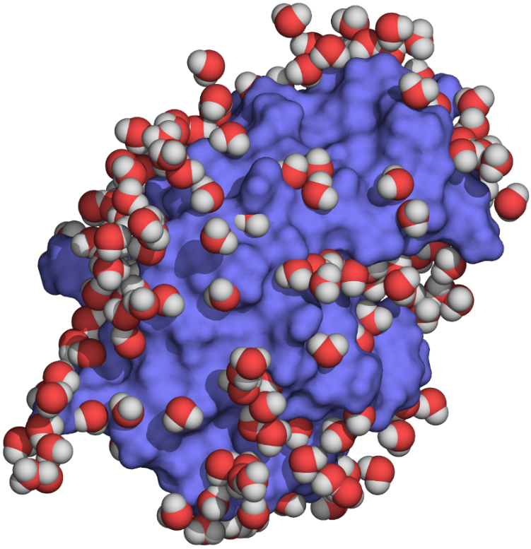
Neutron scattering
Neutrons:
Wavelength (~0.1-10 Å) - on the atomic separation scale
Scattered by atomic nuclei
Sensitive to nuclear mass → strong signal with heavy isotopes:
No need for crystallization
Location of hydrogen atoms (²H)
Notes:
Since neutrons are scattered by atomic nuclei and not by the electron shells, the scattering depends on nuclear mass, spin, and isotopic type, rather than on atomic size. Thus, even the location of hydrogen atoms can be found by using a sample in which the ¹H atoms (protium) have been replaced with ²H (deuterium).
Neutron scattering can be carried out on the protein in solution, but high-resolution structures are usually obtained with crystals, by using neutron diffraction (next slide).
Figure 3.4. Three-dimensional structure of hen egg lyzozyme (PDB entry 1io5) determined by neutron quasi-Laue diffraction at 2 Å resolution. The protein is shown in blue surface representation and the surrounding (deuterated) water molecules as spheres colored by atom type. Unlike as X-ray diffraction, Neutron scattering is able to resolve the hydrogen atoms in the sample, thus revealing the location and orientation of the protein's hydration shell. The image shows the first hydration shell of the protein. These solvent molecules are very close to the protein surface, and display a behavior quite different than bulk solvent molecules (see Chapter 5 for details).

Slide 22
Neutron scattering
Neutrons:
Have a magnetic moment → scattered also by magnetic fields (e.g. emanating from unpaired electrons) → can be used for studying electronic distribution in certain atoms

Slide 23
Neutron scattering
Coherent neutron scattering:
Results from correlated interactions with the nuclei
Provides information on the structure of the molecule
Structure-determining methods:
Neutron diffraction: uses crystals, yields high resolution
Small angle neutron scattering (SANS): applied on large proteins and complexes; yields low-resolution structures 10-12 nm); good for finding arrangement of subunits

Slide 24
Neutron scattering
Incoherent neutron scattering:
Results from the interaction of neutrons with individual nuclei that are in motion
Provides information on the dynamics of the molecule
Elastic (EINS) – atomic vibrations
Quasi-elastic (QINS) – diffusive motions or shifts between near-native conformations
Inelastic (IINS) – vibrational/rotational transitions between different energy levels

Slide 25
Neutron scattering
Advantages:
Determining hydrogen atoms location (protonation states, water)
Mapping the subunit locations in large complexes
Little/no damage to sample
Mapping electronic distribution in certain atoms
Shortcomings:
Expensive - requires larger installations for generating neutrons
In diffraction, large crystals and long exposure required
Notes:
Because the method is so expensive, only ~100 structures are currently available in the PDB.

Slide 26
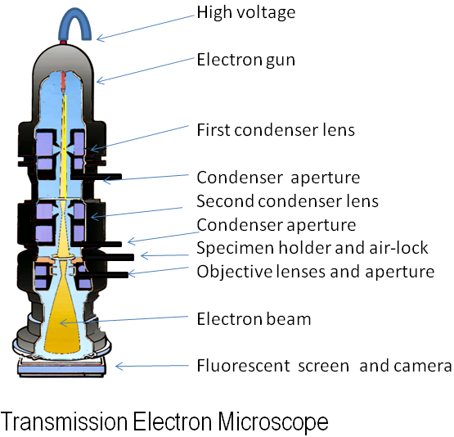
Electron microscopy
Electrons:
Wavelength (< 0.04 Å) - on the atomic separation scale
Negatively charged → can be focused by electromagnetic lenses → can be viewed directly (no need for 3D crystals)
Notes:
Figure 3.5. Electron microscopy. (a) The transmission electron microscope. The electron beam generated by the electron gun is focused onto the specimen by electromagnetic lenses ^{[81]}. The deflected electrons hit a photographic film or an electron-sensitive camera, which creates an image. In protein structure-determination applications of EM, numerous images are recorded and processed (not shown). The figure was created by Graham Beards ^{[111]}.

Slide 27
Electron microscopy
Electrons:
However: low energy → low resolution
Notes:
(b) Low-resolution EM structures of large protein complexes. The image shows a cutaway view through the density map of the splicosomal protein p14 (gray). The yellow part in the middle of the structure is a peptide derived from the p14-associated U2 snRNP component SF3b155, for which an X-ray crystal structure also exists (see ribbon inside the density map). The figure was taken from ^{[112]}.

Slide 28
Electron microscopy
Solution 1: electron crystallography:
Solution: 2D crystals (easier to produce)
MicroED (3D micro-crystals)
Lysozyme
(microED, 2.5 Å)
Aquaporin
(2D crystals, 1.9 Å)
Notes:
2D crystals contain only one or two layers of the molecule. They could not be used by X-ray crystallography because the X-rays, which interact with atoms ~×10⁴ less strongly than electrons, would just pass through the crystals. To get a 3D image from these crystals, the latter are tilted in different ways and the data is collected each time.
(c-I) electron crystallography. Left – a 2.5 Å structure of lysozyme obtained by using the microED technique (PDB entry 5a3e ^{[92]}). Right – the 1.9 Å assembly of lens Aquaporin-0 (AQP0) inside a lipid bilayer, obtained by using 2D crystals (PDB entry 2b6o ^{[91]}). In the assembly, packing interactions between AQP0 tetramers (shown as ribbons) are mediated by lipid molecules (shown as green wires).

Slide 29
Electron microscopy
Solution 2: motion-correcting detectors:
Allow direct, single-particle recording (no crystals)
Rotavirus VP6 protein (2.6 Å)
Notes:
(c-II) single-particle EM. The image shows the 2.6 Å structure of rotavirus VP6 protein (PDB entry 3j9s ^{[113]}).

Slide 30
Electron microscopy
Reducing radiation damage:
In the past: negative staining (immersion in heavy metal → using a stronger electron beam)
Today: cryogenics (cryo-EM) - better resolution but lower contrast
Notes:
Negative staining provides good contrast, but since the metal cannot penetrate the protein fully, the template included only the surface of the protein.
Cryo-EM involves quick freezing of the sample in liquid ethane, nitrogen or helium. This creates a layer of vitreous ice that is almost identical in structure to liquid water. Thus, despite the very low temperature (-346°F to -320°F), the environment of the protein in the sample is still considered to be more natural than in crystals.

Slide 31
Electron microscopy
Advantages:
Direct observation of the protein in different environments
Does not (necessarily) require crystallization
Atomic/near atomic resolutions are available today
Can be applied to any protein larger than ~200 kDa
Shortcomings:
Requires the sample to be put in vacuum
High resolution usually requires crystallization
Instrumentation and maintenance are expensive

Slide 32
NMR spectroscopy
Principles:
A strong external electric field applied by the NMR machine to the sample results in spatial alignment of protein atoms with nuclear spin (e.g. ¹H, ¹³C , ¹⁵N)
An energy pulse transiently disturbs this alignment
The nuclei revert to their original state while emitting radio waves that are sensed by the NMR machine
The waves are different for each atoms, and affected by their atom neighbors (chemical shift)
By using the known chemical shifts of nuclei at different chemical environments, the structure of the protein can be deciphered from its NMR spectrum
Notes:
Spectroscopy is a field that includes different analytic methods, all based on the interaction of molecules with electromagnetic radiation, followed by changes in the energy levels of the former ^{[119]} (excitation, relaxation, etc.). These changes lead to emission of energy from the irradiated molecule, which can be recorded by the instrumentation. Since the magnitude and/or frequency of the emission usually depend on the local chemical environment of the emitting atoms, it can be used for drawing structural information on the investigated molecule.
'nuclear spin‘ is a quantum property that result from the motion of charges in their nucleus. The motion creates a magnetic field around the nucleus that has a moment (μ) proportional to the spin. Atoms with nuclear spins have an unequal number of protons and neutrons.
The external field aligns the spins in two ways that differ in their energy and between which the spin resonates, hence the name.
Figure 3.6. Nuclear magnetic resonance spectroscopy. (a) 1-dimensional H-NMR spectrum map of phenol (prepared by Cfromber ^{[120]}). The different peaks in the spectrum correspond to different proton types in the molecule, as noted. For example, the peak of the hydroxyl proton is well separated from the one corresponding to the aromatic ring protons.

Slide 33
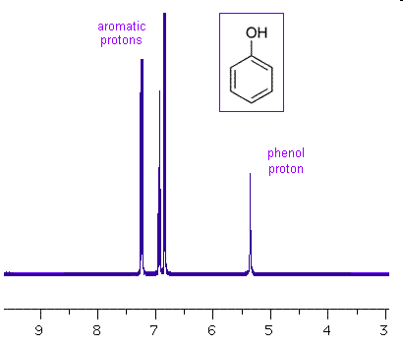
NMR spectroscopy
Principles:
1D NMR spectrum of protons from different locations in a phenol molecule:
Signal
Wavelength
Notes:
Figure 3.6. Nuclear magnetic resonance spectroscopy. (a) 1-dimensional H-NMR spectrum map of phenol (prepared by Cfromber ^{[120]}). The different peaks in the spectrum correspond to different proton types in the molecule, as noted. For example, the peak of the hydroxyl proton is well separated from the one corresponding to the aromatic ring protons.

Slide 34
NMR spectroscopy
Principles:
In macromolecules, deciphering the structure from the signal requires analyzing the couplings between different atoms:
J-coupling: exists between covalently bonded nuclei; its measurement (COSY) reveals atom connectivity in the molecule
Notes:
NOE - Nuclear Overhauser Effect

Slide 35
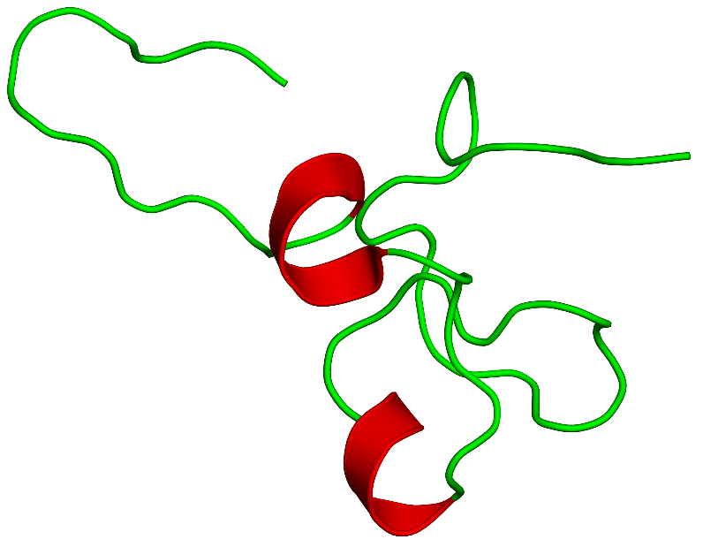
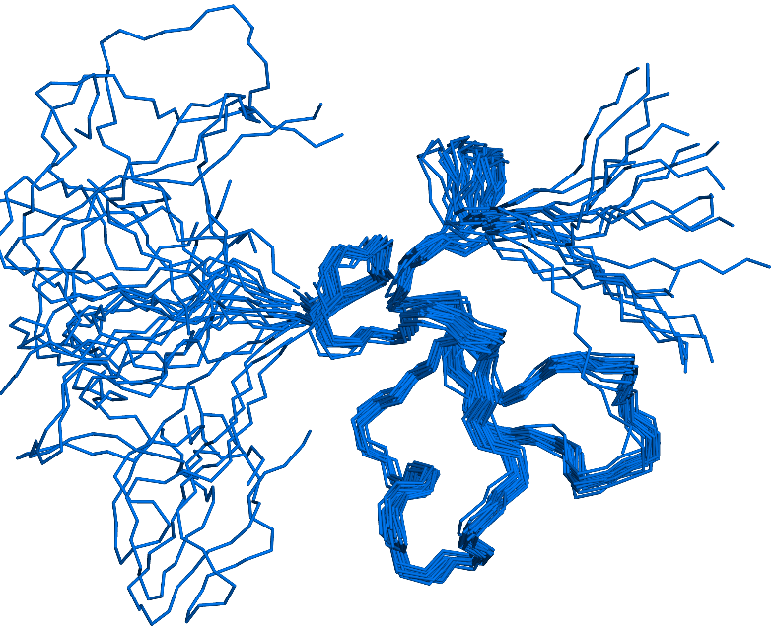
NMR spectroscopy
Principles:
In macromolecules, deciphering the structure from the signal requires analyzing the couplings between different atoms:
NOE coupling: occurs between proximal (< 5 Å) non-bonded nuclei; its measurement (NOESY) reveal all possible locations of non-bonded atoms → structural ensemble → dynamics
Notes:
Thus, NOESY does not provide a single structure, but rather an ensemble of structures that are consistent with the spatial constraints
(b) NMR structure. The figure shows the secondary structure of the somatomedin B domain of human vitronectin (PDB entry 1ssu) (left) and the corresponding 20-mer ensemble (right). All the structures of the ensemble are within the distance constraints indicated by the NMR measurements. Clearly, the central part of the structure is much more ordered than the flanking edges.

Slide 36
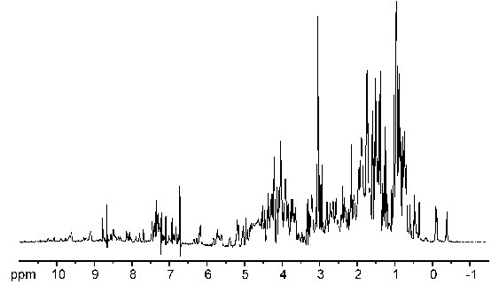
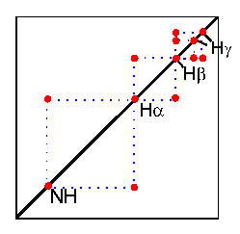
NMR spectroscopy
Principles:
The multiple peaks can also be resolved by conducting 2 or more measurements (2D/3D/4D NMR)
Further resolution can be achieved by labeling the sample with ¹³C or ¹⁵N, and/or replace ¹H with ²H
1D NMR
(www.cryst.bbk.ac.uk)
2D NMR
Notes:
When the measurement is carried out repetitively the time difference between the consecutive measurements allows adjacent nuclei to affect each other and form a correlation.

Slide 37
NMR spectroscopy
Advantages:
The structure is determined in native environment (solution, membrane powder) → dynamics, no crystals required
The protein's hydration layer can be studied
NMR is sensitive to weak interactions → studying binding events
The radio waves do not harm the sample
Shortcomings:
Limited to small proteins (≤ ~40 kDa)
Notes:
Solid-state NMR allows the measurements to be conducted on membrane proteins, or on proteins, which form amyloid precipitates.
The size limitation of NMR results from the difficulty to resolve the numerous spectrum lines.

Slide 38
Electron paramagnetic resonance (EPR) spectroscopy
Principles:
Similar to NMR, but relates to the spin of unpaired electrons
Often requires spin-labeling (when there are not enough unpaired electrons)
The dependence on the label limits the data to local structures within the protein

Slide 39
Other spectroscopic methods
Fluorescence spectroscopy:
A fluorophore is electronically excited by UV/blue radiation and emits fluorescent light
The emission is sensitive to the molecular environment (quenching)
Provides data on local structures and degree of folding
Fluorophores: aromatic residues, organic tags
Fluorescence resonance energy transfer (FRET):
Two tags are chosen so energy transfer happens only when they are very close

Slide 40
Other spectroscopic methods
Fourier transform infrared (FTIR) spectroscopy
Raman spectroscopy
Circular dichroism (CD) spectroscopy:
Allows to determine secondary structures, protein-ligand interactions, and structural disorder
Relies on the absorption of UV polarized light by peptide bonds
The repeating geometries of secondary structure produce typical CD spectra that can be identified
Mass spectrometry

Slide 41
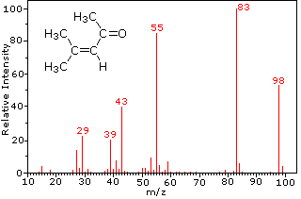
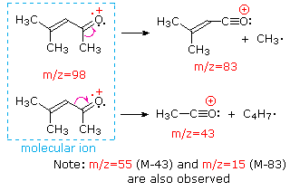
Mass spectrometry
Principles:
The sample is ionized by an intense electron beam
The ions are separated by electric and magnetic fields according to mass and charge
The ions are identified by a sensor (mass/charge spectrum)
(created by William Reusch)
Notes:
Figure 3.7. Mass spectrometry. (a) Mass spectra of 4-methyl-3-pentene-2-one. The full spectra is shown on the left. The right image shows the ion of the intact molecule and the ions of two fragmentation products. The images were created by Prof. William Reusch and used with permission.

Slide 42
Mass spectrometry
Principles:
The composition of the sample can found by comparing the results to known mass of elements/molecules
Identification can also be done by using known spectra of molecules (fingerprints) - allows high-throughput studies
(created by William Reusch)
Notes:
Figure 3.7. Mass spectrometry. (a) Mass spectra of 4-methyl-3-pentene-2-one. The full spectra is shown on the left. The right image shows the ion of the intact molecule and the ions of two fragmentation products. The images were created by Prof. William Reusch and used with permission.

Slide 43
Mass spectrometry
Principles:
To ionize large molecules:
Electrospray ionization (ESI):
No size limit
Keeps non-covalent complexes intact (protein-ligand interactions)
Can couple MS to liquid chromatographic methods (LC/MS) for better separation → good for complex samples
However, requires a constant flow of the sample

Slide 44
Mass spectrometry
Principles:
To ionize large molecules:
Matrix-assisted laser desorption/ionization (MALDI):
The ions are produced by pulsed-laser irradiation of the sample that is co-crystallized with a solid matrix
Quick → good for high-throughput studies
Synchronization between ion formation and analysis → high sensitivity; sample does not have to keep flowing
High tolerance to salts and buffers → good for biological samples
Most suitable for analyzing peptides

Slide 45
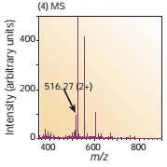
Mass spectrometry
Applications:
Protein identification, quantification & sequencing
Requires separation & enzymatic digestion to peptides
Notes:
Figure 3.7. Mass spectrometry. (b) A generic mass spectrometry procedure for proteins. Step 1: the proteins to be analyzed are isolated from cell lysate or tissues by biochemical fractionation or affinity selection. This often includes a final step of one-dimensional gel electrophoresis. Step 2: the proteins are degraded enzymatically to peptides, usually by trypsin. Stage 3: the peptides are separated chromatographically in very fine capillaries and eluted into an electrospray ion source where they are nebulized in small, highly charged droplets. After evaporation, the peptides enter the mass spectrometer. Stage 4: a mass spectrum of the peptides eluting at this time point is taken. The image is taken from ^{[161]}.

Slide 46
Mass spectrometry
Applications:
Protein identification, quantification & sequencing
Allows sequencing of peptides and then entire proteins
High-throughput → allows proteomic analysis of organisms
Allows identification of post-translational modifications

Slide 47
Mass spectrometry
Applications:
Characterizing 3D structure and mapping interactions
¹H-²H exchange mass spectrometry (HDX-MS)
Monitoring ¹H-²H exchange in protein’s amide groups → position and secondary structure of different parts (exchange is slower in parts that are buried or hydrogen-bonded)
Hydroxyl-radical footprinting
Follows rate of radical-induced hydroxylation of side-chains to identify buried parts (OH is heavier than CH₃)

Slide 48
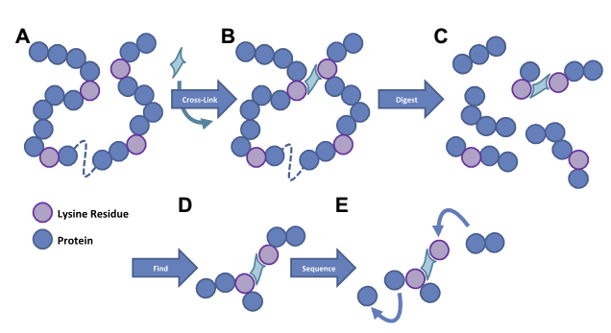
Mass spectrometry
Applications:
Characterizing 3D structure and mapping interactions
Chemical crosslinking
Crosslinkers are used to attach segments close in 3D space
After degradation non-linear fragments are identified
Notes:
Figure 3.7. Mass spectrometry. (c) Protein analysis by cross-linking MS. Step 1: the protein is incubated with a residue specific cross-linking reagent. Residues within the range of the cross-linking reagent are covalently bonded. Step 2: the protein is enzymatically digested to form peptides. Step 3: data-dependent acquisition is used to identify peptides as they elute from an HPLC directly coupled to the mass spectrometer. Step 4: the identified peptides are then fragmented to provide sequence specific information. The image is taken from ^{[154]}.

Slide 49
The protein data bank (PDB)
The most comprehensive database of protein structures determined experimentally
Contains both proteins and complexes (nucleic acids, lipids, carbohydrates, small molecules)
Manually curated
PDB sites:
US site (RCSB): http://www.rcsb.org/pdb
World-wide site (wwPDB): http://www.wwpdb.org/
European site (PDBe): http://www.ebi.ac.uk/pdbe
Japanese site (PDBj): http://pdbj.org/
Notes:
Currently (October 2016), the PDB contains over 123,600 structures, 93% of which are proteins, 90% determined by X-ray crystallography.

Slide 50
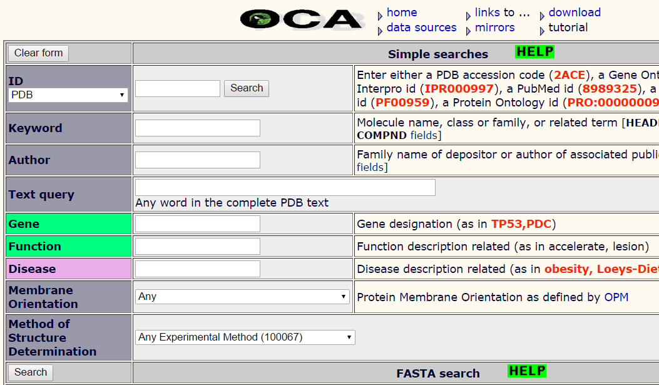
The protein data bank (PDB)
Notes:
Figure 3.15. The Protein Data Bank. (a) One of the PDB electronic search forms available on the Internet.

Slide 51
b
Atom number
Atom name
Residue name
Residue number
Occupancy
Chain
X
Y
Z
B-factor
Notes:
The occupancy is 1.00 when one conformation is reported for an atom. For more conformations, each has an occupancy level according to its percentage (e.g. 0.3 and 0.7).
The B-factor is a measure of flexibility (the displacement of the atomic positions from an average (mean) value). They are normally between 15 and 30 Å² (https://proteinstructures.com/Structure/Structure/proteinstructure-databases2.html).
(b) The structural coordinates of a protein deposited in the PDB. Besides the coordinates, the PDB file also contains other structurally relevant parameters, specified in the figure. Only the first two amino acids are presented.

Slide 52
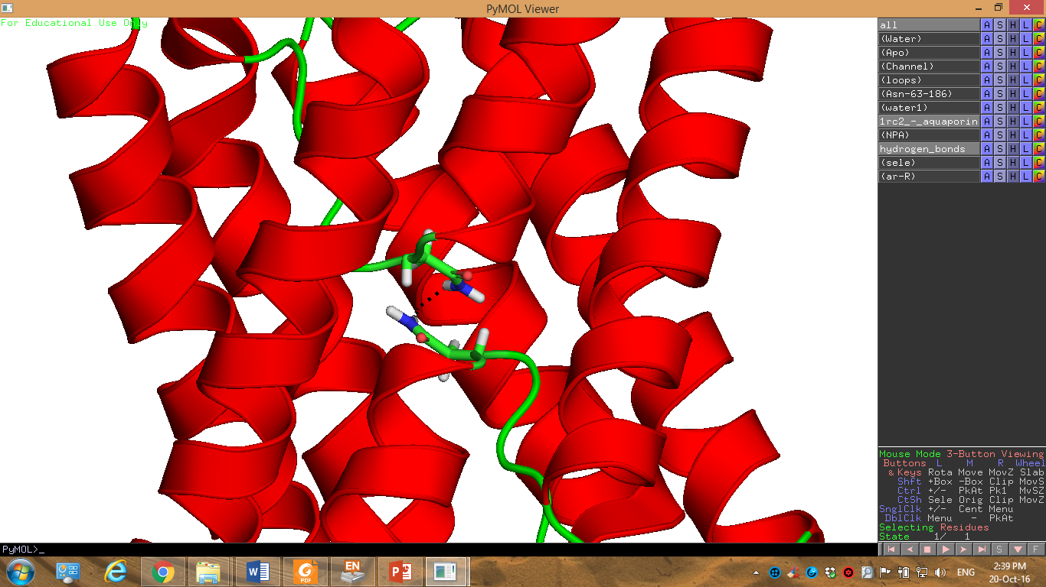
Viewing protein structures
Software like PyMOL and Chimera allow viewing, analysis, and manipulation of molecular structures
Proteins representation by PyMOL

Slide 53
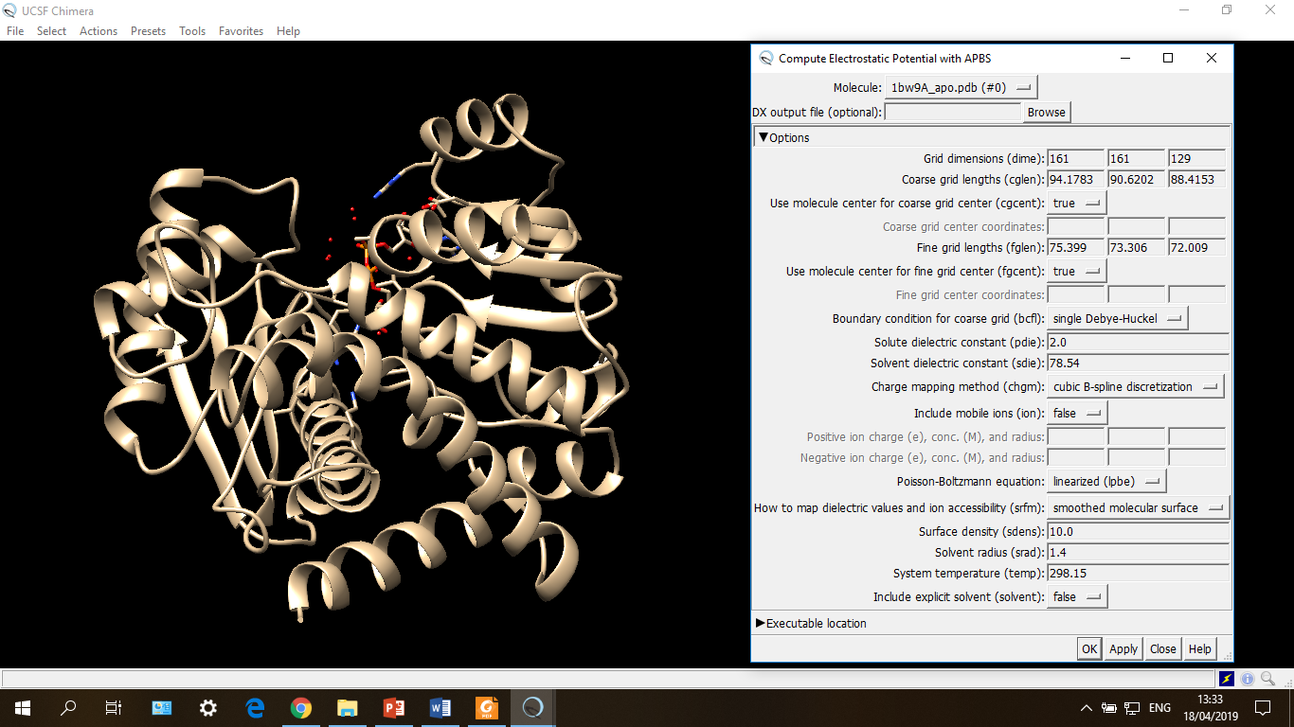
Viewing protein structures
Several viewers have plugins that interface with other software, for advanced calculations and computational predictions
A Chimera plugin interfacing with APBS (electrostatic calculations)

Slide 54
The protein data bank (PDB)
More information provided by the PDB file (header)
Protein source (organism)
Method of determination
Resolution
Amino acid sequence
Location of secondary structures
Electron density map (recent)
Corresponding article
Links to other sequence and structural databases

Slide 55
The protein data bank (PDB)
Problems:
90% are X-ray structures → bias against membrane and complex proteins, dynamics is ignored
Bias towards medically/pharmaceutically-important proteins
Standardization problems (atom names, ligands, etc)

Slide 56
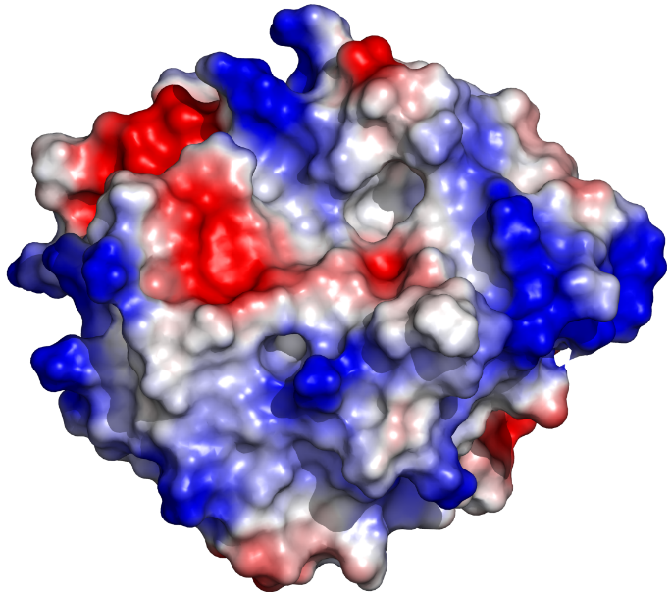
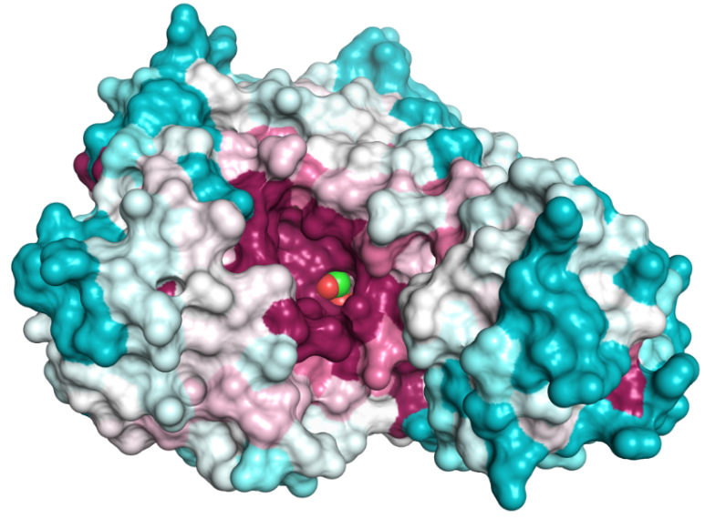
Analysis of protein structures
Computational software can be used for analyzing various properties of protein structures. Examples:
Evolutionary conservation (e.g. the ConSurf server)
Electrostatic properties (e.g. DelPhi and APBS)
Binding to other molecules (e.g. AutoDock, Glide, GOLD)
Stability (e.g. PoPMuSiC, CAPSAT, Eris)
Proteins colored by evolutionary conservation (left) and electrostatic potential (right)

Slide 57
Computational Prediction of Protein Structure

Slide 58
Why predict protein structure?
Lab methods provide accurate 3D structures
However:
They are slow
Some are expensive
Membrane proteins are a problem
Thus, only a small part of known proteins have solved structure
Computational methods are less accurate, but faster and cheaper
Notes:
Today (19/07/20) there are over 166,500 structures in the PDB. This number is only a fraction of the number of proteins in nature. For example, in UniProt there are 26 million entries that share no more than 50% of their sequence (a measure of the number of unique proteins). So, only ~0.6% of the proteins have solved structures.

Slide 59
Overview
The physical (ab initio) approach
Force-field-based calculation of the potential energy
Configurational sampling
The mean-field approach
The template-based (comparative) approach
Homology modelling
Fold recognition
Integrative methods
Experimentally guided computational prediction
Evolutionary methods (correlated mutations)

Slide 60
The physical approach

Slide 61
The physical approach
Assumptions
Protein folding involves a free energy decrease
The native structure has the least free energy (global minimum)
G₁
G₂
ΔG = G₂ - G₁ < 0
Notes:
Figure 2.23. Solvent exposure of various protein regions in the folded vs. unfolded states. Polar and nonpolar residues are colored in magenta and green, respectively. The solvent (water) molecules surrounding the protein are represented as spheres. In the folded state, nonpolar residues reside mainly in the protein core away from the solvent, whereas in the unfolded state both polar and nonpolar residues are exposed to the solvent. Still, the folded state contains patches of hydrophobic residues, as explained in the main text. Water molecules were added to the protein computationally by the PDB_hydro server ^{[277]} (Delarue group, Institut Pasteur ^{[278]}).

Slide 62
The physical approach
Assumptions:
The folding process can be followed, given:
An explicit description of the unfolded structure and its surrounding (water, ions, lipids)
A mathematical description of the total energy of the system in a given configuration (‘force field’)
An algorithm for sampling different configurations of the system, to find the lowest-energy one (native)
Notes:
A configuration is the exact spatial distribution of all system atoms at a certain point in time.

Slide 63
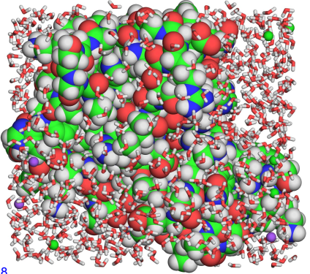
The physical approach
Explicit system description
Protein
Water
Na⁺
Cl⁻
Notes:
Figure 3.8. Explicit description in molecular mechanics calculation. (a) A small globular protein (barnase, PDB entry 1b2x) soaked in solvent, which includes water molecules and ions (0.5 M NaCl). The protein is presented as atom spheres colored by atom type, whereas the surrounding water molecules are presented as sticks. Na⁺ and Cl⁻ ions are presented as small yellow and magenta spheres, respectively. All atoms should be included in the simulation.

Slide 64
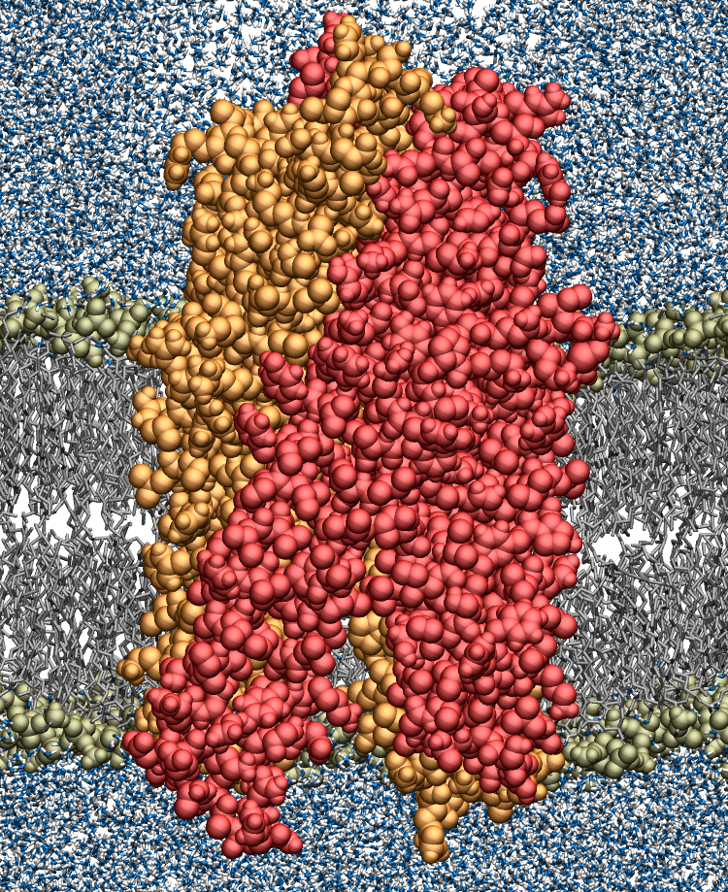
Lipid head groups
Water
Lipid tails
Protein
Lipid
bilayer
Notes:
(b) A molecular dynamics snapshot of the ABC transporter Sav1866 in a palmitoyl-oleoyl phosphatidylethanolamine (POPE) lipid bilayer, surrounded by aqueous solvent. The lipid head groups and the protein are shown in a space-fill representation, whereas the lipid tails and aqueous solvent are shown in a wire-frame representation. Lipid molecules are gray; water molecules are blue (oxygen) and white (hydrogen); and the two protein subunits are colored in red and orange, respectively. Courtesy of Drew Bennett and Peter Tieleman, University of Calgary.

Slide 65
The physical approach
Force-field-based calculation of the potential energy
Folding involves a drop in the free energy of the system:
G₁
G₂
ΔG = G₂ - G₁ < 0
Notes:
Figure 2.23. Solvent exposure of various protein regions in the folded vs. unfolded states. Polar and nonpolar residues are colored in magenta and green, respectively. The solvent (water) molecules surrounding the protein are represented as spheres. In the folded state, nonpolar residues reside mainly in the protein core away from the solvent, whereas in the unfolded state both polar and nonpolar residues are exposed to the solvent. Still, the folded state contains patches of hydrophobic residues, as explained in the main text. Water molecules were added to the protein computationally by the PDB_hydro server ^{[277]} (Delarue group, Institut Pasteur ^{[278]}).

Slide 66
The physical approach
Force-field-based calculation of the potential energy
The potential energy can approximate the free energy:
ΔG = ΔH - TΔS_{sys}
(constant temp)
(ΔE + Δ(PV))
(ΔU + ΔK)
ΔG = ΔU + ΔK + Δ(PV) - TΔS_{sys}
In biological systems:
ΔG = ΔU + ΔK - TΔS_{sys}
Notes:
G is the ‘useful’ energy in the system, i.e. energy that can be used for doing non-expansion work. True calculation of the free energy can only be done by QM methods. Therefore, an approximation must be used.
The potential energy results from all covalent and most non-covalent interactions (except nonpolar) in the molecular system.
The kinetic energy depends on the temperature. If the latter doesn’t change, than ΔK = 0
[Note: the dependence of ΔG in ΔH and TΔS is when all these physical parameters correspond to the system. When the entropy of the universe is used, then ΔG = -TΔS_{universe}, which means that as the entropy increases the free energy becomes more negative. It also means that ΔS_{universe} includes ΔH.]

Slide 67
The physical approach
Force-field-based calculation of the potential energy
U is calculated using a force-field (molecular mechanics):
covalent bond length
covalent bond angle
covalent bond dihedral angle
improper dihedral angle
vdW interactions
electrostatic interactions
Notes:
Figure 3.1.1. A simple force field. (a-d) The dependency of the potential energy of the system on the following covalent bond factors: (a) Length, r_{i}. (b) Valence angle, θ_{i}. (c) Dihedral angle, φ_{i}. (d) Improper dihedral angle, ω_{i}, i.e. deviation from planarity. In all cases, the interaction is depicted as a comparison between the actual value found in the coordinate file (e.g., r_{i} and θ_{i}) and the theoretical equilibrium value (e.g., r_{i,0} and θ_{i,0}). The parameters k_{r,i}, k_{θ,i}, k_{φ,i}, k_{ω,i}, are the force constants of interactions (a)-(d), respectively. (e) The dependency of the van der Waals potential energy on the distance (r_{ij}) between interacting atoms i and j. A_{ij} and B_{ij} are parameters associated with the van der Waals interaction. (f) The dependency of the electrostatic potential energy on the local dielectric (ε), and the distance (r_{ij}) between atoms i and j, with charges q_{i} and q_{j}.

Slide 68
The physical approach
Configurational sampling
Option 1: sampling all possible configurations randomly and finding the lowest-energy one - impractical
Option 2: Energy minimization
Calculate the potential energy of unfolded protein
Introduce small changes in atoms location and recalculate
If energy is lower – accept and do steps 1-2 again. If energy is higher, make another change until energy is lower

Slide 69
The physical approach
Configurational sampling
Problem: random changes in atomic locations may drive the system towards higher-energy configurations
Solution: the changes in atom location are predicted in response to the force applied on the atoms (molecular dynamics)
velocity
position
acceleration
-
mass
position
(Newton’s 2nd law of motion)

Slide 70
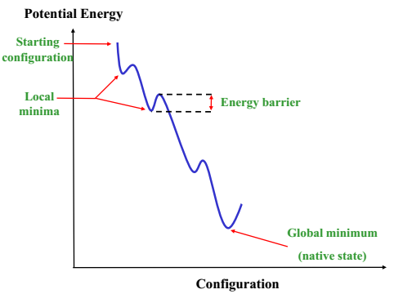
The physical approach
Configurational sampling
Problem: protein folding involves local energy minima → the simulation gets the stuck!
Notes:
Figure 3.9. Local energy minima and barriers in proteins. The hypothetical energy landscape of a protein-solvent system is shown. In the plot, each distinct system configuration is characterized by a potential energy value. During a simulation, different configurations are sampled in a certain pattern. As the plot demonstrates, finding the global energy minimum (corresponding to the most stable ‘native state’ configuration) often requires the simulation to overcome energy barriers that separate different local energy minima.

Slide 71
The physical approach
Configurational sampling
Solution: the kinetic barriers are overcome by virtual heating, which translates into atomic motions (simulated annealing)
Extensive sampling allows to estimate ΔS_{sys}:
S = k_{B}lnΩ
number of possible system configurations

Slide 72
The physical approach
MD cannot describe protein folding. Why?
Explicit models → the simulations cover ns-μs (folding takes ms)
The potential energy is just an approximation of the free energy
The description of bonds as springs is highly approximated
Solvation effects are not fully accounted for
The force constants are obtained by fitting calculations to empirical data

Slide 73
The physical approach
So why use MD?
Refining models
Producing near-native structures
Exploring dynamic changes in proteins
Learn about the separate contributions to the total free energy
Deriving structure-function relationships
Engineering proteins

Slide 74
The physical approach
Implicit (mean-field) calculations
MD’s biggest problem: describing all electrostatic interactions between fixed protein charges and mobile solvent charges (solvation/polarization energy)
G_{elec} =

Slide 75
The physical approach
Implicit (mean-field) calculations
Solution:
Fixed protein charges – described by charge distribution (ρ)
Mobile solvent charges - described by the dielectric (ε)
G_{elec} – described as a function of ρ and the potential (Φ)
Notes:
Notice that ΔG_{elec} includes both the Coulomb energy and the polarization energy.
Notice that Φ, ρ and ε are position-specific parameters.
Figure 3.10. Implicit (mean-field) description of protein-based systems. The figure shows a continuum-solvent model of the system, which is a type of mean-field treatment. In this model, the protein is described explicitly, whereas the solvent is described implicitly, using its dielectric properties. Two common continuum-solvent models are shown. (a) A globular protein in a high-dielectric environment representing the aqueous solution. (b) A membrane-bound protein in a heterogeneous environment, which includes a high-dielectric aqueous solvent and a low-dielectric slab of fixed dimensions, representing the hydrocarbon region of a biological lipid bilayer (in semi-transparent yellow).

Slide 76
The physical approach
Implicit (mean-field) calculations
The elec. potential:
Notes:
Figure 1.3.1. The electrostatic potential. The potential (Φ) is the energy acquired by a probe charge (q₂) positioned within an electrostatic field (black arrows) that is emitted by a source charge (q₁). This is also a way to measure the potential.

Slide 77
The physical approach
Implicit (mean-field) calculations
G_{elec} is calculated as follows:
The entire system is mapped on a grid
Φ is calculated at all grid points (Φ - the energy of a charge in an electric field)
ρ∙Φ is integrated over all points to get G_{elec}:

Slide 78
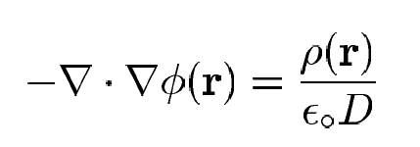
The physical approach
Implicit (mean-field) calculations
Φ is calculated by the Poisson equation
In a uniform dielectric:
ε
_{i}
2
ε
_{e}
_{h}
_{f}

Slide 79
The physical approach
Implicit (mean-field) calculations
Φ is calculated by the Poisson equation
In a protein-solvent system:
In the presence of mobile ions, the Poisson-Boltzmann equation is used:
(I - the ionic strength in the system)

Slide 80
The physical approach
Implicit (mean-field) calculations
Faster, better account of solvation effects
However: specific water/lipid effects are neglected
Mixed force fields: combine explicit calculations on the protein with mean-field calculations on the solvent

Slide 81
The physical approach
Implicit (mean-field) calculations
The total nonpolar energy (hydrophobic + vdW) is derived using an empirical surface area dependency:
change in buried surface area upon folding

Slide 82
Template-based methods
The 3D structure of the query protein is deduced from proteins of known structure (templates) that:
Have a very similar sequence to the query protein (homologs)
Share physicochemical properties or statistical tendencies with the query protein
Main methods:
Homology modeling
Fold recognition via threading

Slide 83
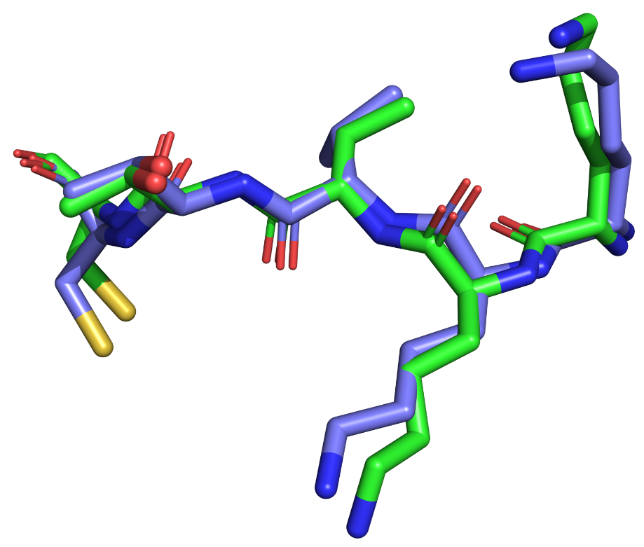
Measuring structural similarity
R.M.S.D - root-mean-square deviation
δ ²₍₃₎
N - the number of equivalent atoms compared between the two structures
δ_{i} - the distance (in Å) between the atom pair i (one from each protein):
δ²₍₁₎
δ² = (x_{a}-x_{b})² + (y_{a}-y_{b})² + (z_{a}-z_{b})²
δ ² ₍₂₎
Smaller R.M.S.D = more similar structures

Slide 84
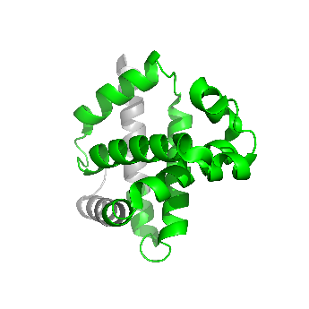
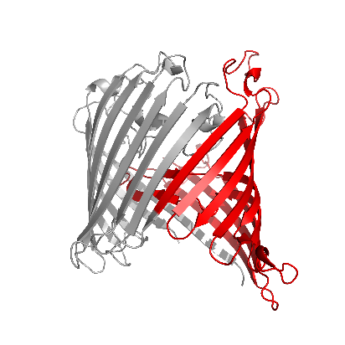
Template-based methods
Homology modeling: basic logics
Proteins with similar sequences have similar structures
Thus, the structure of a protein can be predicted based on the structures of its sequence homologs
Templates
Query
Notes:
Chothia and Lesk noted that proteins with 50% sequence identity have a corresponding structural r.m.s.d. of ~1 Å

Slide 85
Template-based methods
Homology modeling: steps
Finding templates with ≥ 30% sequence identity in shared regions (psi-BLAST)
Aligning the two sequences
Transferring the coordinates of identical amino acids from the template to the query protein
Performing energy optimization to get rid of clashes and distortions
Model evaluation (WHATIF, Verify3D) – also for ranking models
Software/servers: Modeller, SwissModel, NEST
Notes:
Model evaluation is done based on statistical tendencies: bond lengths/angles, residue occurrence in secondary structures, residue burial, etc.
50% identity → rmsd = 1-2 Å (in regions covered by the templates)
30-50% identity → rmsd = 2-4 Å

Slide 86
Template-based methods
Homology modeling: multiple sequence alignment
MSA quality usually determines model accuracy
Software: Clustal-ω, MAFFT, MUSCLE, T-Coffee
Notes:
Figure 3.11. Multiple sequence alignment. (a) Part of a multiple sequence alignment of homologous glucokinase enzymes. For clarity, the different residue types (e.g. polar-neutral, nonpolar, charged, etc.) are colored differently. The alignment was taken from the Pfam database ^{[308]}. The sequence names are listed on the left and the sequences are aligned to maximize the amino acid similarity in each column without opening too many sequence gaps.

Slide 87
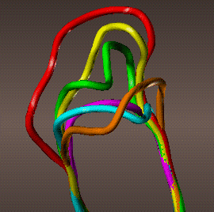
Template-based methods
Homology modeling: problems
The number of available templates is limited
Loops have low conservation → difficult to predict
Partial solution: using other methods for loop prediction
Still, HM is currently the best method for structure prediction
Notes:
The shortage of templates is especially severe in membrane proteins, which are hard to crystallize.

Slide 88
Template-based methods
Fold recognition: basic logics
Proteins of similar structures share certain sequence-encoded properties or statistical tendencies
Thus, a protein of known structure can serve as a template if it has similar properties/tendencies to those of the query protein
http://csb.stanford.edu/class

Slide 89
Template-based methods
Fold recognition: types of properties/tendencies
Amino acids-related: angles, surface area, polarity, 2nd structure preference, etc.
Purely statistical – detected from multiple sequence alignment
http://csb.stanford.edu/class

Slide 90
Template-based methods
Fold recognition: steps
Each position in the query protein is coded in a way describing the specific tendencies of this position. This yields a sequence profile for the query protein
The profile is systematically compared to a library containing the profiles of all proteins of known structure
A match represents a protein with similar fold
If a match is not found, the query protein is assumed to have a novel fold
Software/servers: GenTHREADER, SPARKS-X, HHPred, TASSER

Slide 91
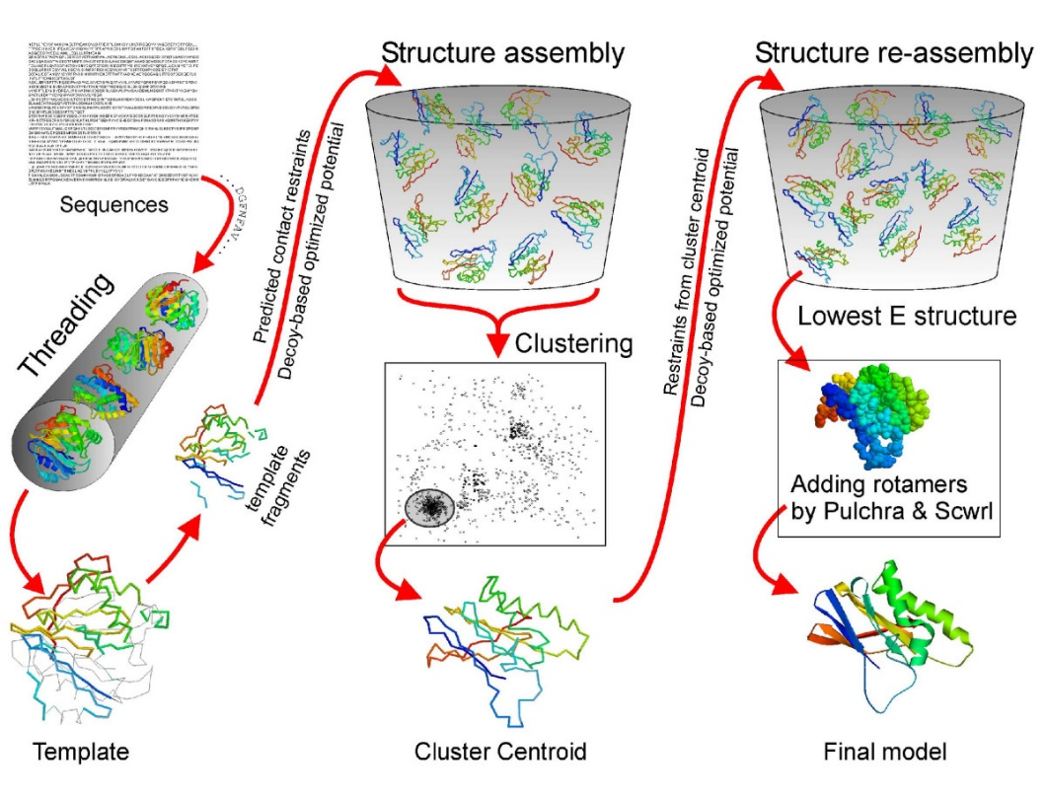
Template-based methods
Integrative methods
Integrate different approaches to get best results
E.g.: HM for initial models, energy methods for refinement
Software/servers: I-TASSER, Rosetta
Notes:
I-TASSER uses threading to find templates, then cuts the best aligned fragments from the structures and re-assembles them using MC simulations and energy refinement.
Figure 3.12 The I-TASSER protocol for protein structure prediction. The figure is taken from ^{[361]} and used under the terms of the Creative Commons Attribution License (http://creativecommons.org/licenses/by/2.0).

Slide 92
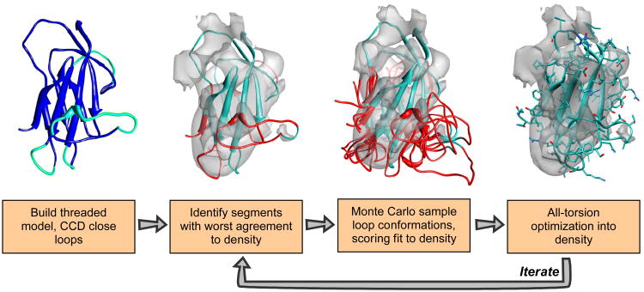
Template-based methods
Experimentally guided methods
Structural data are derived from low-resolution lab methods (EM, SAXS) and used as constraints in computational structure prediction
A Rosetta implementation with cryo-EM constraints
Notes:
Figure 3.14. Model building by guiding Rosetta’s comparative modeling using cryo-EM density maps. A threaded model is built from some alignment (blue), using cyclic coordinate descent to close gaps in the alignment (cyan). This model is then docked into the EM density map, and regions with poor local agreement with the density data are identified (red). The conformations in these regions are aggressively resampled, with each potential conformation scored with Rosetta's low-resolution energy function together with an agreement-to-density score. Finally, sidechain rotamers are optimized and all backbone and sidechain torsions are minimized using Rosetta's high-resolution potential, also augmented with this agreement-to-density score. These three steps are iterated over until the lowest-energy models converge, at each iteration enriching the population for those models with both favorable Rosetta energy as well as good fit to density.

Slide 93
Databases of predicted structures
ModBase (Andrej Šali’s comparative models DB): https://modbase.compbio.ucsf.edu/
The protein model database (PMDB): http://srv00.recas.ba.infn.it/PMDB/
AlphaFold Protein Structure Database (at EMBL): http://srv00.recas.ba.infn.it/PMDB/

Slide 94
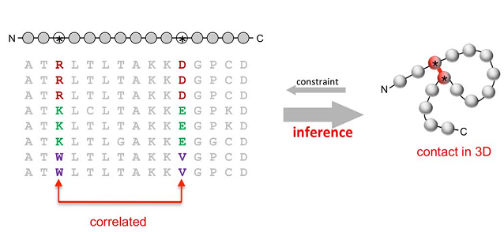
Evolutionary methods
Prediction by correlated mutations
Positions that are close in space tend to co-evolve
Therefore, data on co-evolving positions can be used as distance constraints on structure prediction
PLoS One (2011) 6: e28766
Notes:
Figure 3.3.1. Structure prediction based on identification of correlated mutations. The process is based on the inference of contacts between nearby residues in the native structure of a protein from correlated mutations in its sequence. (a) The prediction process, demonstrated for clarity on two positions forming a single 3D contact. Left: Multiple sequence alignment of the target protein with the sequences of other family members, all of which have the same fold. The two correlated positions are marked. Right: A schematic representation of the 3D structure of the folded protein, showing the proximity of the two correlated positions.

Slide 95
Evolutionary methods
Prediction by correlated mutations
The sequence information is used to build a contact map, which is integrated into a structure prediction algorithm.
Notes:
Figure 3.3.1. Structure prediction based on identification of correlated mutations. (b) A contact map of top-ranked evolutionary inferred couplings (EICs) (red) overlaid on contacts from a crystal structure of human β₂-adrenergic receptor (grey). The top 350 evolutionary couplings are shown, covering nearly the entire length of the protein. EICs between residues that are less than 5 Å away from each other are omitted; hence, there are no red marks along the long diagonal. The dark and light green bars on the axes show the locations of experimentally-determined and predicted α-helices in the sequence, respectively; these are easily inferred from the high density of EICs along the short diagonals. The light blue areas correspond to a large flexible loop missing from the crystal structure. The image was adapted from the Evfold ^{[374]} website by Yana Gofman.

Slide 96
Evolutionary methods
Prediction by correlated mutations
Web servers: EVcouplings, RaptorX-Contacts, GREMLIN, DESTINI

